Slide 1

2. Spectral Vectors and Angles
Dr. David R. Thompson
Jet Propulsion Laboratory, Imaging Spectroscopy Group

Slide 2
Goals for this module
Use basic mathematical tools including vector normalization and distance metrics
Use the spectral angle mapper to identify at least three of our target signatures

Slide 3
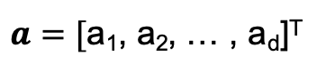
Spectra are vectors
Imagine each spectrum is a vector, e.g. a point in d-dimensional space, represented by d numbers each.
An image cube becomes a data cloud of points.
… now generalize this idea to 400 channels. We can’t visualize this, but the same mathematical tools apply.
Spectra
Channel 2
$a=[$a₁, a₂, … , a_{d}]^{T}
Channel 1

Slide 4
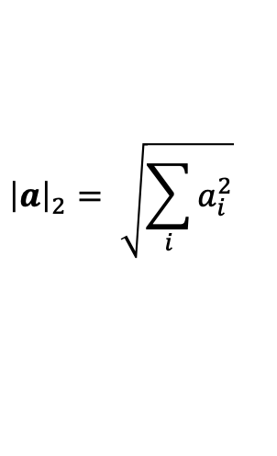
Normalization
Vectors have direction and magnitude. Often we don’t care about the magnitudes of spectra, so we normalize them to some standard. To normalize a vector, we divide by the ”L2” (Euclidean)) norm defined as:
$${\left|a\right|}_{2}= \sqrt{\sum_{i}{a_{i}^{2}}}$$
Other norms are possible. For example, the ”L1 norm” is the sum of elements.
All normalizations have the effect of equalizing the magnitudes of spectra to similar levels of brightness.

Slide 5
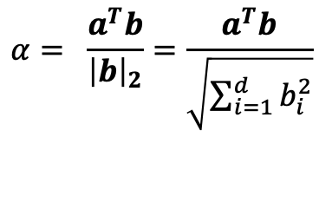

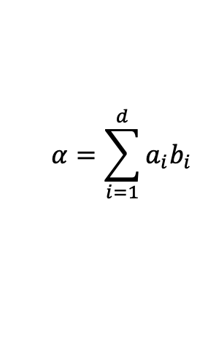
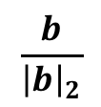
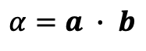
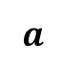
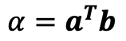

The dot product operator
For $d$-dimensional column vectors $a$ and $b$, their dot product $α$ is the scalar sum of element-wise products written:
$$α=\sum_{i=1}^{d}{{a_{i}b}_{i}}$$
$$α=a ∙ b$$
alternatively,
$$α=a^{T}b$$
alternatively,
If $b$is normalized, this is the magnitude of the orthogonal projection of $a$ onto $b$:
$$a$$
$$α= \frac{a^{T}b}{{\left|b\right|}_{2}}=\frac{a^{T}b}{\sqrt{\sum_{i=1}^{d}{b_{i}^{2}}}}$$
$$\frac{b}{{\left|b\right|}_{2}}$$
$$α$$
It describes the similarity between $a$and $b.$

Slide 6
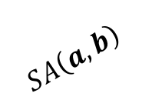
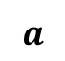
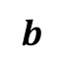
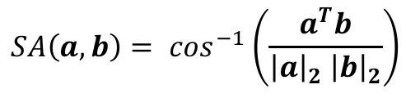
The Spectral Angle
The spectral angle is the arccosine of the normalized dot product. It describes the angle between two high-dimensional vectors.
$$a$$
$$SA\left(a,b\right)= \cos^{−1}\left(\frac{a^{T}b}{{{\left|a\right|}_{2} \left|b\right|}_{2}}\right)$$
$$b$$
$$SA\left(a,b\right)$$
It quantifies the match between spectral shapes, and is invariant to vector magnitudes.

Slide 7
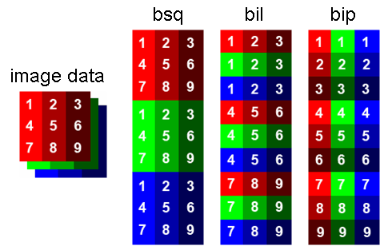
A note on the “interleave” of spectral data
The “interleave format” specifies the ordering of the data cube’s dimensions in the computer memory. For a two dimensional array, there are only two options (column- or row-major). For a 3D cube, there are many more! These three conventions are most common.
Image courtesy EnMap-box
Band interleaved-by-line (BIL): [row, channel, column]
Band-sequential (BSQ): [channel, row, column]
Band interleaved-by-pixel (BIP): [row, column, channel]

Slide 9
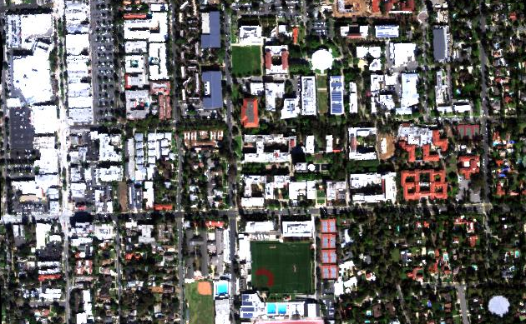
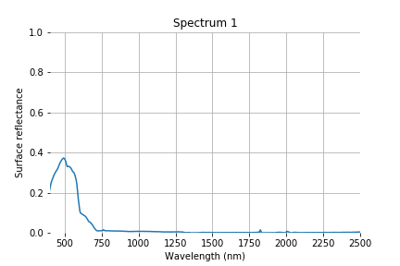
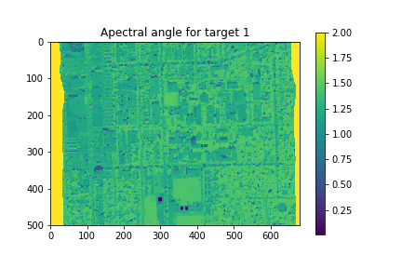
Exercise 2: Spectral angle mapping
Full spectrum data cube
Target signatures (1 of 12)
Spectral Angle Calculation
N
100 m
Objective: Automate the scavenger hunt!
Calculate the spectral angle map for every signature.
Save a map for each answer. Does it match your intuition?
Spectral angle for target 1

